Slide 1
FINAL PROJECT
TOPIC: EMPLOYEE ATTRITION

Slide 2
TABLE OF CONTENT
INTRODUCTION
PROBLEM STATEMENT
VISUALIZATION
CONCLUSION

Slide 3
INTRODUCTION
A large company employs at any given point of time, around 4000 employees. However, every year, around 15% of its employees leave the company and need to be replaced with the talent pool available n the job market.

Slide 4
PROBLEM STATEMENT
The management believes that the level of attrition (employees leaving, either on their own or because they got fired) is bad for the company, because of the following reasons:
The former employees’ projects get delayed, which makes it difficult to meet timelines, resulting in a reputation loss among consumers and partners.
A sizeable department has to be maintained, for the purposes of recruiting new talent.
More often than not, the new employees have to be trained for the job and/or given time to acclimatize themselves to the company.

Slide 5
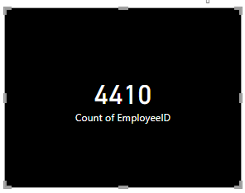
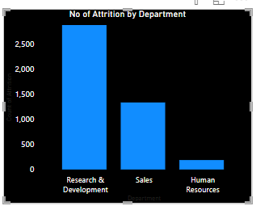
VISUALIZATIONS

Slide 6
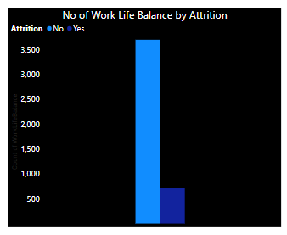
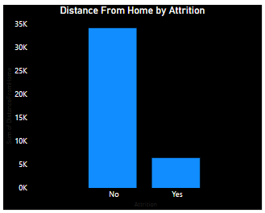
VISUALIZATION CONT…

Slide 7
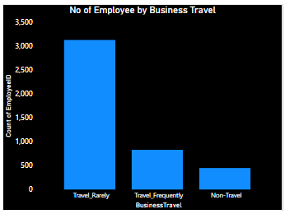
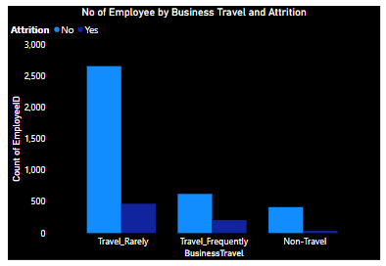
VISUALIZATION CONT…

Slide 8
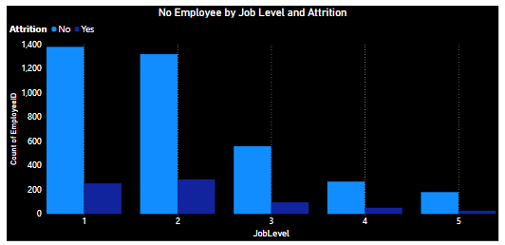
VISUALIZATION CONT…

Slide 9
CONCLUSION
The number of employee that are still in the company is higher than the number of employee that has left.
The total number of employee in the company is 4410
Research and Development department has the highest numbers of employee
The number of employee that live far from home is very high
Level 5 has the highest job level.
Most employee in the company rarely travel.

